Slide 1
Facilitating Indigenous Ministries
Promoting unhealthy dependency
or
practicing biblical advocacy?
Eric Vess
ANM US Director: Reaching the Remaining Unreached (RRU)

Slide 2
Polarizing Statements
Mission Strategy Grenades

Slide 3
Polarizing Statements
“Send money, never send people!”

Slide 4
Polarizing Statements
“Send money, never send people!”
“Send people, never send money!”

Slide 5
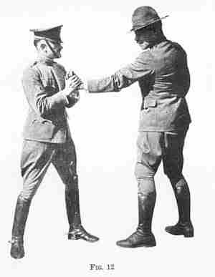
Polarizing Statements
“Send “Send
MONEY PEOPLE
not not
people!” money!”

Slide 6
We send people because Christ commands it!
(Matt 28:19; Mark 16:15; also see: Rom 10:15)

Slide 7
We send people because Christ commands it!
(Matt 28:19; Mark 16:15; also see: Rom 10:15)
We send money (& other resources) because Scripture exhorts believers to provide for their household (family) and the household of faith (church) & provides examples of financial gifts to meet needs. (1 Tim 5:7; Gal 6:10; 2 Cor 9:1-5)

Slide 8
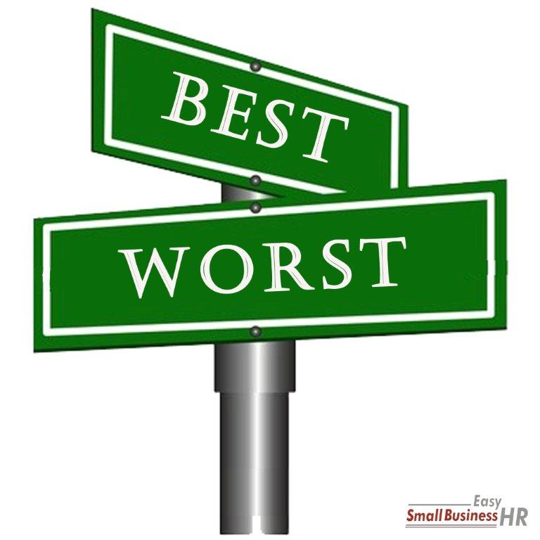
Not all “send money” projects
are biblically healthy,
just as not all “send people”
approaches are missiologically sound.

Slide 9
The real issue is, when we send
people and money, are we following
biblical “best practices?”
And what can we learn from our
failures, or “worst practices?”

Slide 10
A “Send Money” Case Study:
Project: Building the largest church
building & training center in country
Partners: A US-based para-church
partnership ministry and a prominent
national (indigenous) pastor

Slide 11
Key Issues
Motive & Agenda Issues:
Both leaders are convinced that the project will enhance the spread of the Gospel in country
By providing a larger training facility for church planters
By fulfilling the national pastor’s vision to train new church planters for all regions of the country
Both leaders also believe that the project will help build the reputation and status of the national pastor

Slide 12
Key Issues
Personality & Relational Issues:
Both leaders are entrepreneurs w/minimal accountability
National pastor is leader of 2nd largest church in country
Para-church leader defines partnership as a marriage
Para-church leader agrees to fund based primarily on
personal relationship with the national pastor

Slide 13
Key Issues
Accountability & Financial Issues:
Both leaders accustomed to making unilateral decisions
National pastor pushes project despite opposition from his church, especially his church board
No NGO bank account is possible (at the time), thus all funding is sent to the pastor’s personal bank account
National pastor puts building up as collateral on loans
National pastor pays bribes to insurgent group

Slide 14
Key Issues
Outcomes & Impacts:
Project is completed at a cost of US$300,000+
Public dedication service is well attended by all partners
Pastor’s church board refuses to move worship to new site
Pastor’s loans are foreclosed and building goes to creditors
Building becomes a movie theater and everyone knows
Pastor’s church splits 4 ways and all partnerships end
Para-church leader is asked by his board to step down

Slide 15
What do we learn?
Worst Practices:
Size = Impact fallacy / Vision = the big idea fallacy

Slide 16
What do we learn?
Worst Practices:
Size = Impact fallacy / Vision = the big idea fallacy
Biblically unbalanced partnership paradigm

Slide 17
What do we learn?
Worst Practices:
Size = Impact fallacy / Vision = the big idea fallacy
Biblically unbalanced partnership paradigm
Unilateral decision making / lack of accountability

Slide 18
What do we learn?
Best Practices:
Examine our motives for every project/partnership:
Ask: Whose “vision” is it? (2 Sam 7:1-7)
Ask: Has God asked for this? (7:7)

Slide 19
What do we learn?
Best Practices:
Examine our partnership paradigm:
Is our ministry partnership healthy, mutual, accountable, and relational? (Phil 1:3-11; Ecc 4:9-12)
Healthy: Is the relationship spiritually/doctrinally sound?
Mutual: Is there giving and receiving by all parties?
Accountable: Are decisions subject to checks/balances?
Relational: Is the partnership short-term-project; or
long-term-relationship focused?

Slide 20
What do we learn?
Best Practices:
Examine the project’s accountability structure:
Is there an “abundance of counselors?” (Proverbs 24:3-7)
Is there a thoughtful plan to complete? (Luke 14:28-30)

Slide 21
9 Two are better than one, because they have a good reward for their toil. 10 For if they fall, one will lift up his fellow. But woe to him who is alone when he falls and has not another to lift him up! 11 Again, if two lie together, they keep warm, but how can one keep warm alone? 12 And though a man might prevail against one who is alone, two will withstand him—a threefold cord is not quickly broken.
Ecc 4:9-12

Slide 22
Facilitating Indigenous Ministries
Eric Vess
ANM US Director
Reaching the Remaining Unreached (RRU)
eric@adnamis.org
ecvess@gmail.com
www.advancingnativemissions.com

